Slide 1
Voice of contention
WebAIM, Léonie Watson

Slide 2
Hello!

Slide 3
Speaking clocks

Slide 4
Architecture

Slide 5
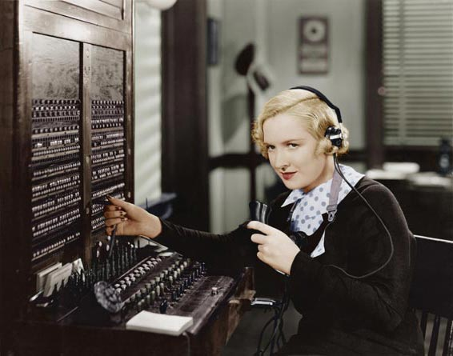
Glass discs

Slide 6
Quality

Slide 7

Ethel Jane Cain
“At the third stroke it will be 11 25 precisely”

Slide 8
Pat Simmons
“At the third stroke it will be 8 57 precisely”

Slide 9
Brian Cobby
“At the third stroke it will be 9 59 and 20 seconds”

Slide 10
Sara Mendez Da Costa
“At the third stroke it will be 2 43 and 20 seconds”

Slide 11
Content design

Slide 12
Precisely
“At the third stroke the time will be 6 45 precisely”
[3 measured beeps]

Slide 13
And 10 seconds
“At the third stroke the time will be 1 58 and 10 seconds”
[3 measured beeps]

Slide 14
Home assistants

Slide 15
Architecture

Slide 16


In the cloud
Home assistants
Cloud-based applications

Slide 17
Quality

Slide 18
Neural TTS
Neural TTS uses artificial neural networks trained on huge amounts of voice data. The neural networks learn the relationships between text and speech, and the result is voices that sound very close to human speech.
Notes:
Neural (NTTS) uses a single end-to-end process that's trained on vast amounts of speech data.

Slide 19
Clones
Neural TTS can transfer the prosodic characteristics of one voice to another, making it possible to synthesize speech in the voice of a particular speaker (with comparatively little individual training data).

Slide 20
Content design

Slide 21

Speech Synthesis Markup Language (SSML)
SSML 1.0 W3C Recommendation (2004)
SSML 1.1 W3C Recommendation (2010)

Slide 22
Emotion
“I’m so excited”

Slide 23
Voice profiles
"This just in. Alexa can now deliver the news like a professional newscaster.
The 'newscaster' voice emphasizes specific words and phrases for a more compelling delivery of the news.
The changes in the news delivery are subtle but it is easier to tell when a sentence ends or when Alexa is reading a headline."

Slide 24
Adaptive behaviour
“Shh. Be very, very quiet”

Slide 25
Assistive tech

Slide 26
Architecture

Slide 27

On device
Web readers
Screen readers

Slide 28
Quality

Slide 29
Formant TTS
Formant synthesis is rule based. The acoustic characters of speech are extracted from a voice recording, then programmed as rules for recreating the voice as digital audio.

Slide 30
Concatenative TTS
Concatenative synthesis uses a voice recording that's broken down into tiny chunks. The chunks are then reconstructed from a database to form the synthesized speech.

Slide 31
Parametric TTS
Parametric synthesis uses a statistical model. The parameters of speech are extracted from a voice recording, then Hidden Markov Models (HMM) modify the parameters based on the text to be spoken.
Notes:
Traditional TTS uses rule-based or statistical techniques, dependent on pre-defined linguistic and acoustic models, with a two step process:
1. Linguistic analysis
2. Acoustic production

Slide 32
Content design

Slide 33
Words
I read a good book last week. I’d like to read it again some day.
Natural Deeper Adult Female:
“I [red] a good book last week. I’d like to [reed] it again some day.”

Slide 34
More words
Someone gave me flowers tied with a bow, as I took a bow on stage.
Natural Deeper Adult Female:
“Someone gave me flowers tied with a [bow], as I took a [bow] on stage.”

Slide 35
Numbers
1.4.8 1.4.9 1.4.10
Natural Deeper Adult Female (US Accent):
“1 4 8, 1 4 9, January 4th 2010”

Slide 36
Numbers again
1.4.8 1.4.9 1.4.10
Natural Adult Female (English Accent):
“1 4 8, 1 4 9, the 1st of April 2010”

Slide 37

CSS Speech
Working Group Note (2019)
W3C Candidate Recommendation (2020)

Slide 38
The speak property
{speak: auto;}
Notes:
Other values are never and always.

Slide 39
The voice-family property
voice-family: “Voice Name 1”, “Voice Name 2”;
https://speech-api-voices-gatherer.glitch.me/
Notes:
Takes the names of available voices in preference order.

Slide 40
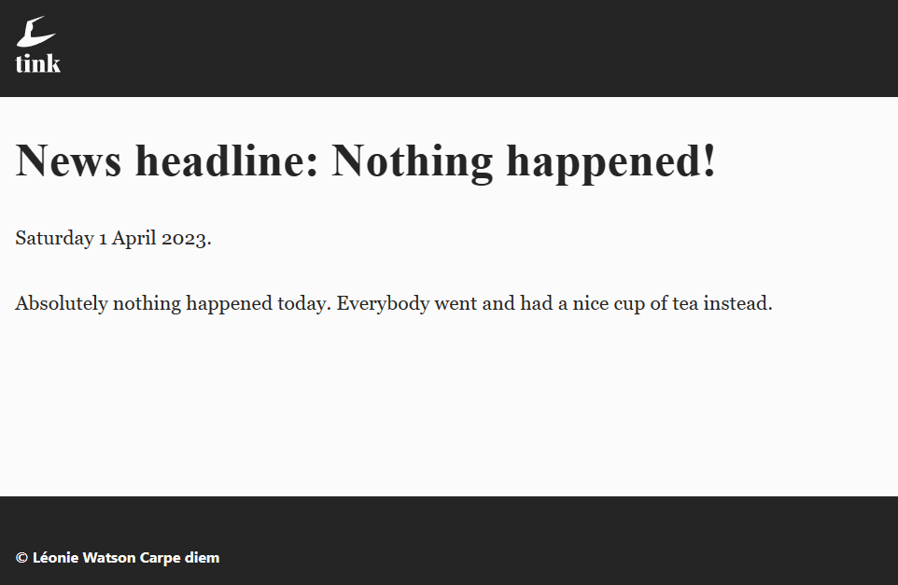
Rent a Crowd

Slide 41
The prosody properties
{
voice-volume: normal;
voice-pitch: normal;
voice-rate: normal;
}
Notes:
Other voice-volume values are x-soft, soft, medium, loud, x-loud.
Other voice-pitch properties are x-low, low, medium, high, x-high.
Other voice-rate values are: x-slow, slow, medium, fast, x-fast.

Slide 42
Caps indicator
“If text is in all CAPS it is spoken at a higher pitch”

Slide 43
Spelling rate
“Words are spelled more slowly than they're spoken “

Slide 44
The emphasis properties
{
voice-stress: normal;
voice-range: medium;
}
Notes:
The other voice-stress values are strong, moderate, none, reduced.
The other voice-range values are x-low, low, high, x-high.

Slide 45
The pause properties
{
pause-before: medium;
pause-after: medium;
}
Notes:
Other pause-before and pause-after properties are none, x-weak, weak, strong, x-strong.

Slide 46
The speak-as property
{
speak-as: spell-out;
}
{
say-as: digits;
}
Notes:
Other say-as values are literal-punctuation, no-punctuation.

Slide 47





OS override

Slide 48

Relative values

Slide 49
Better UX

Slide 50

Jean Luc Picard

Slide 51
Thank you!
WebAIM, Léonie Watson

